Slide 1
PROFESSIONAL ETHICS CE3124
Introduction to Professional Ethics and its importance
Faculty of Engineering,
General Sir John Kotelawala Defence University
19th January 2024

Slide 2
TOPICS
Ethics
Individual ethical decision making – moral philosophies and values,
Organizational ethical decision making – role of ethical culture and leadership
Rules to Professional Ethics in the Workplace

Slide 3

ETHICS
The discipline dealing with what is good and bad, and with moral duty and obligation

Slide 4
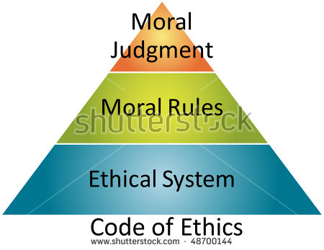
ETHICS
The principles of conduct governing an individual or group (professionals)

Slide 5
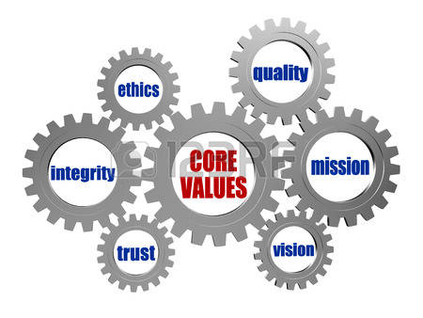
ETHICS
The value structure that guides the actions of an individual or corporate body, in his/her/their dealings with any other person, or with society in general.

Slide 6
WHAT IS ETHICS ???
First, ethics refers to well-founded standards of right and wrong that prescribe what humans ought to do, usually in terms of rights, obligations, benefits to society, fairness, or specific virtues.
Secondly, ethics refers to the study and development of ethical standards, either for an individual or for an organization
Notes:
Ethics, for example, refers to those standards that impose the reasonable obligations to refrain from rape, stealing, murder, assault, slander, and fraud. Ethical standards also include those that enjoin virtues of honesty, compassion, and loyalty. And, ethical standards include standards relating to rights, such as the right to life, the right to freedom from injury, and the right to privacy. Such standards are adequate standards of ethics because they are supported by consistent and well-founded reasons.
As mentioned above, feelings, laws, and social norms can deviate from what is ethical. So it is necessary to constantly examine one's standards to ensure that they are reasonable and well-founded. Ethics also means, then, the continuous effort of studying our own moral beliefs and our moral conduct, and striving to ensure that we, and the institutions we help to shape, live up to standards that are reasonable and solidly-based.

Slide 7
WHO IS A PROFESSIONAL ???
Definition of professional
a : of, relating to, or characteristic of a profession
b : engaged in one of the learned professions
c (1) : characterized by or conforming to the technical or ethical standards of a profession
(2) : exhibiting a courteous, conscientious, and generally businesslike manner in the workplace
Professionals and those working in acknowledged professions, exercise specialist knowledge and skill.
How the use of this knowledge should be governed when providing a service to the public can be considered a moral issue and is termed professional ethics.

Slide 8
PROFESSIONAL ETHICS
Professional Ethics are a set of standards that describe the professional behavior that is expected in all fields of work.
in a corporate environment professionals have to deal with moral and ethical issues that arise from their work
Frequently, professionals in a corporate environment are confronted with dilemmas that have no simple answer, and Professional Ethics examines the moral and ethical issues that arise in a corporate environment.

Slide 9
PROFESSIONAL ETHICS
It has been found that a majority of professionals face ethical problems in their professional life, as compared to non-professionals, mainly because professionals are trained to provide services to the society, that cannot be provided by non-professionals
It is because of the services that professionals provide, they are also eligible for certain privileges and immunities.
  Examples:
    Doctors
    Engineers
    Commercial Airplane Pilots
Because of these added responsibilities and complicated scenarios, it’s difficult to understand the way a person is expected to act under complex situations. Professional Ethics is a way to provide an answer to those difficult questions through extensive training, sharing real-life examples, and following the practices that makes a profession ethical.
Notes:
Doctor – a surgeon is licensed to operate on a person, because of his/her knowledge and training. Anyone else trying to cut open another will be charged, ranging from grievous bodily harm to murder !!! Negligence
Engineer – specialisd in structures is entrusted with the design of a building, because he/she is expected to do the design to the relevant engineering standards and codes, so as to ensure a building that could be used safely. Wilful non-compliance with standards, which could result is structural failure resulting in injury or death is now punishable
Airplane pilots – are entrusted with the lives of the passengers on board. Split second decisions to be made, inspite of the high tech systems. Sullenberg – Airbus 320 – loss of power due to a bird strike - safely land in Hudson River
Pilots & Alcohol - Flying an aircraft is a profoundly demanding job. Pilots are trained to perform the highly complex tasks necessary to get the plane into the sky, navigate safely to the destination and land
The US Federal Aviation Administration (FAA) says: “The majority of adverse effects produced by alcohol relate to the brain, the eyes, and the inner ear — three crucial organs to a pilot.
“Brain effects include impaired reaction time, reasoning, judgment, and memory. Visual symptoms include eye muscle imbalance, which leads to double vision and difficulty focusing. Inner ear effects include dizziness, and decreased hearing perception.”

Slide 10
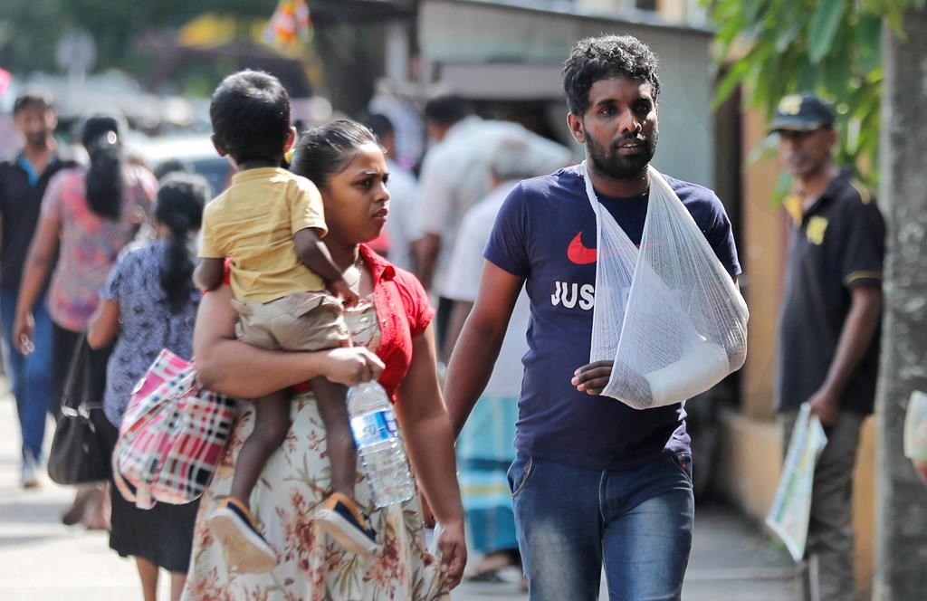
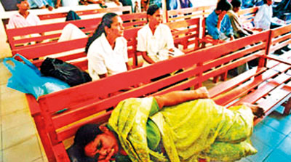
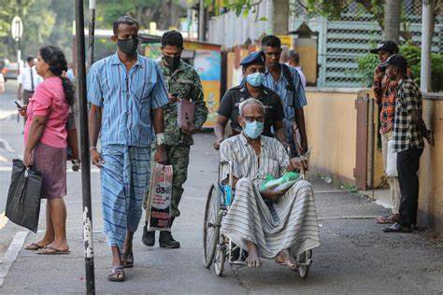
PROFESSIONAL ETHICS - Doctors
The primary role of the Medical Doctor is to look after the well being of their fellow men and the community
As one of clauses of the Hippocratic Oath says,
“I will remember that I remain a member of society, with special obligations to all my fellow human beings, those sound of mind and body, as well as the infirm”
TRADE UNION ACTION ????
IS IT ETHICALLY JUSTIFIED ????

Slide 11
PROFESSIONAL ETHICS - Doctors
Misadventure- A bad result despite good and reasonable effort.
Negligence- A bad result when the effort does not reflect reasonable standards of patient care
Medical Negligence
Although medical accidents and misadventures are an expected social phenomenon, medical negligence is not.
Medical negligence is the breach of a duty of care towards a patient which results in, harm to a patient. This could be by an act of commission or omission by the medical staff.
Earlier this month a female patient died due to a serious case of medical negligence at the Colombo National Hospital.
After a successful surgery the patient was routinely transferred to the Recovery Room. To assist her recovery she was to be given oxygen. There were two cylinders in the room (one with oxygen and one with carbon dioxide) and the nurses there fixed the mask connected to CO₂. When the patient found it difficult to breath, she removed the mask, but the nurses scolded her and forcibly fixed the mask back, forcing her to inhale CO_{2,} which resulted in her death. Cylinders are colour coded – Oxygen is White and CO2 is grey.The Health Ministry tendered an apology, and promised an investigation.
This was manslaughter !!!

Slide 12
PROFESSIONAL ETHICS - Doctors
Deliberately false statements
The Boonwaat Case [1967] : The victim had been shot, and neighbours had heard the gun shots. The doctor was summoned to the ambassador’s residence and certified that death was due to cerebral hemorrhage due to hypertension.
Ethical or Unethical ???
  Abortion
  Euthanasia
Conflict of Interest
I will apply, for the benefit of the sick, all measures which are required, avoiding those twin traps of overtreatment and therapeutic nihilism.
Interdependence between Doctors and Pharmaceutical companies

Slide 13
PROFESSIONAL ETHICS - Engineers
The Engineer’s primary function is to serve the Community, the Public !!
Members of other professions mainly deal with people on a one-to-one basis, whereas Engineers serve the needs of a whole group of people
Some areas where Engineers may act unethically
  Inconvenience the public
  Bring dishonor to the profession
  Act outside their areas of specialty
  Deviate from Engineering Standards & Codes of Practise

Slide 14
Engineering Failure - I-35W Mississippi River bridge
The I-35W Mississippi River bridge was an eight-lane, steel truss arch bridge. It was designed by Sverdrup & Parcel to 1961 AASHTO* standard specifications.
During the evening rush hour on August 1, 2007, it suddenly collapsed, killing 13 people and injuring 145.
The primary cause of the collapse was the undersized gusset plates, at 0.5 inches (13 mm) thick. Contributing to that design or construction error was the fact that 2 inches (51 mm) of concrete had been added to the road surface over the years, increasing the static load by 20%. Another factor was the extraordinary weight of construction equipment and material resting on the bridge just above its weakest point at the time of the collapse. That load was estimated at 578,000 pounds (262 tonnes), consisting of sand, water and vehicles.
In the lawsuit against the firm that designed the bridge, it was argued that much time had passed since the 1960s design work, but US Supreme Court allowed the law suit to proceed. The Designers paid $8.9 million to settle the suit without admitting wrongdoing
* AASHTO – American Association of State Highway & Transportation Officials

Slide 15
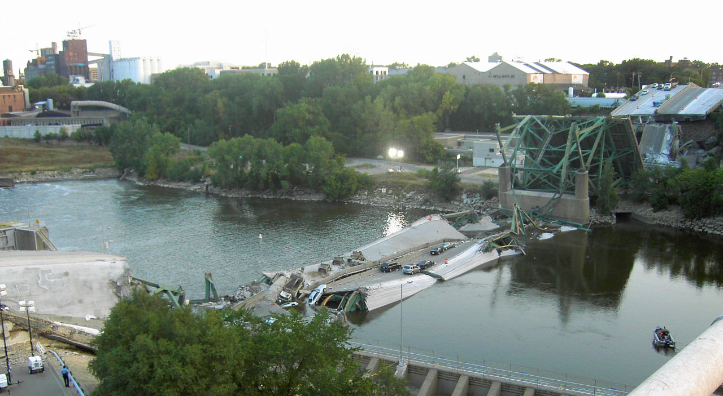
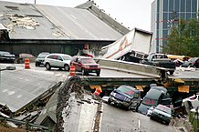
Engineering Failure - I-35W Mississippi River bridge
.

Slide 16
PROFESSIONAL ETHICS – Airplane Pilots
- Flying an aircraft is a profoundly demanding job. Pilots are trained to perform the highly complex tasks necessary to get the plane into the sky, navigate safely to the destination and land
At times they have to make split second decisions to ensure the safety of all those in their charge
UNFIT to FLY !!
US FAA : “The majority of adverse effects produced by alcohol relate to the brain, the eyes, and the inner ear — three crucial organs to a pilot.”
The drink-fly limit is stringent. In the UK it is 20 milligrammes of alcohol per 100ml of blood, compared to the drink-drive limit of 80mg per 100ml.
In August 2015 an Air Baltic flight carrying 109 holidaymakers was grounded in Oslo after four of the five crew members failed alcohol tests.
The pilot was jailed for 10 months and the co-pilot was jailed for 6 months, while the two flight attendants were sentenced to 45 and 60 days.
Sri Lankan aviation authorities suspended the licence of the errant SriLankan Airlines pilot, who failed a breathalyzer test forcing the airline to delay an Airbus A330 flight from Frankfurt to Colombo carrying 274 passengers, by 15 hours.

Slide 17
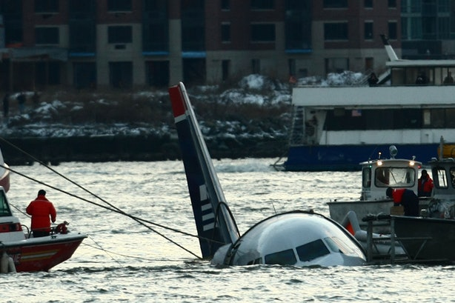
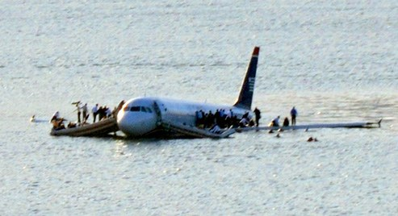
PROFESSIONAL ETHICS – Airplane Pilots
US Airways Flight 1549 was an Airbus A320-214 which soon after takeoff from New York City's LaGuardia Airport on January 15, 2009, struck a flock of Canada geese and consequently lost all engine power. Unable to reach any airport, pilots Chesley Sullenberger and Jeffrey Skiles glided the plane to a ditching in the Hudson River. All 155 people aboard were rescued by nearby boats and there were few serious injuries.

Slide 18
PROFESSIONAL ETHICS
Many people confuse ‘Ethical’ with ‘Legal’.
Legal is the word used to define anything that concerns the law or its workings. It is applicable to all practices, languages, processes, procedures, cultures, and other relative concepts in a system of the law.
Ethics is the word used to define the traditional norms and morals of an individual or society.
Many of the existing laws have originated from ethics, where ethics is rooted in morals and the perception of the rightness or wrongness of an act or conduct.

Slide 19
PROFESSIONAL ETHICS
Any legal act is applicable to all people in a State that implements a particular set of laws. On the other hand, ethics is society or community specific. Two different communities located in the same geo-political region definitely have one rule of law, but they may have two different ethics. For example, in Sri Lanka there is one law applicable to every citizen, but possibly there are several ethics applicable to concerned society only.
In Sri Lanka, several legal systems govern the law of family relations. The General law (a combination of Roman Dutch and English law) is the main system applicable to every one except if they are governed by the personal laws.
There are three other parallel systems of personal laws in Sri Lanka, i.e., Kandyan Law, The Thesavalamai and the Muslim Law. These laws are grounded in ancient customary practices and/or religion.
Personal laws deal with :
  Marriage, Divorce and Maintenance
  Inheritance
  Property

Slide 20
A definition of ethics in terms of standards such as rights and fairness
Some years ago, sociologist Raymond Baumhart asked business people, "What does ethics mean to you?"
"Ethics has to do with what my feelings tell me is right or wrong.“
"Ethics has to do with my religious beliefs.“
"Being ethical is doing what the law requires.“
"Ethics consists of the standards of behavior our society accepts.“
"I don't know what the word means."
Notes:
Some years ago, sociologist Raymond Baumhart asked business people, "What does ethics mean to you?" Among their replies were the following: many people tend to equate ethics with their feelings. But being ethical is clearly not a matter of following one's feelings. A person following his or her feelings may recoil from doing what is right. In fact, feelings frequently deviate from what is ethical.
Nor should one identify ethics with religion. Most religions, of course, advocate high ethical standards. Yet if ethics were confined to religion, then ethics would apply only to religious people. But ethics applies as much to the behavior of the atheist as to that of the devout religious person. Religion can set high ethical standards and can provide intense motivations for ethical behavior. Ethics, however, cannot be confined to religion nor is it the same as religion.
Being ethical is also not the same as following the law. The law often incorporates ethical standards to which most citizens subscribe. But laws, like feelings, can deviate from what is ethical. The US slavery laws and the old apartheid laws of present-day South Africa are grotesquely obvious examples of laws that deviate from what is ethical.
Finally, being ethical is not the same as doing "whatever society accepts." In any society, most people accept standards that are, in fact, ethical. But standards of behavior in society can deviate from what is ethical. An entire society can become ethically corrupt. Nazi Germany is a good example of a morally corrupt society. Sri Lanka 1983
Moreover, if being ethical were doing "whatever society accepts," then to find out what is ethical, one would have to find out what society accepts.
To decide what I should think about abortion, for example, I would have to take a survey of American society and then conform my beliefs to whatever society accepts. But no one ever tries to decide an ethical issue by doing a survey. Further, the lack of social consensus on many issues makes it impossible to equate ethics with whatever society accepts. Some people accept abortion but many others do not. If being ethical were doing whatever society accepts, one would have to find an agreement on issues which does not, in fact, exist.

Slide 21
PERSONAL FEELINGS:
many people tend to equate ethics with their feelings. But being ethical is clearly not a matter of following one's feelings. A person following his or her feelings may retreat from doing what is right. In fact, feelings frequently deviate from what is ethical.
RELIGION
Nor should one identify ethics with religion. Most religions, of course, advocate high ethical standards. Yet if ethics were confined to religion, then ethics would apply only to religious people.
But ethics applies as much to the behavior of the atheist as to that of the devout religious person.
Religion can set high ethical standards and can provide intense motivations for ethical behavior. Ethics, however, cannot be confined to religion nor is it the same as religion.
  Spanish Inquisition
  Conversion – Ethical or Unethical ???

Slide 22
LAW :
Being ethical is also not the same as following the law. The law often incorporates ethical standards to which most citizens subscribe. But laws, like feelings, can deviate from what is ethical. The US slavery laws and the Apartheid laws of South Africa are grotesquely obvious examples of laws that deviate from what is ethical.
SOCIETY STANDARDS :
Finally, being ethical is not the same as doing "whatever society accepts." In any society, most people accept standards that are, in fact, ethical. But standards of behavior in society can deviate from what is ethical. An entire society can become ethically corrupt. Nazi Germany is a good example of a morally corrupt society. Sri Lanka 1983
Moreover, if being ethical were doing "whatever society accepts," then to find out what is ethical, one would have to find out what society accepts.

Slide 23
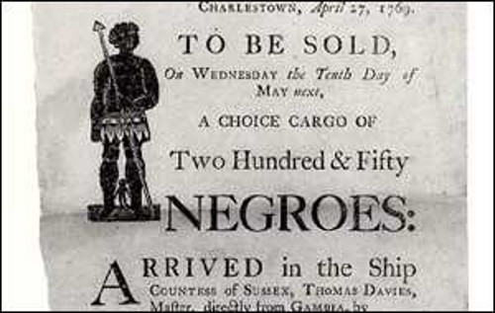
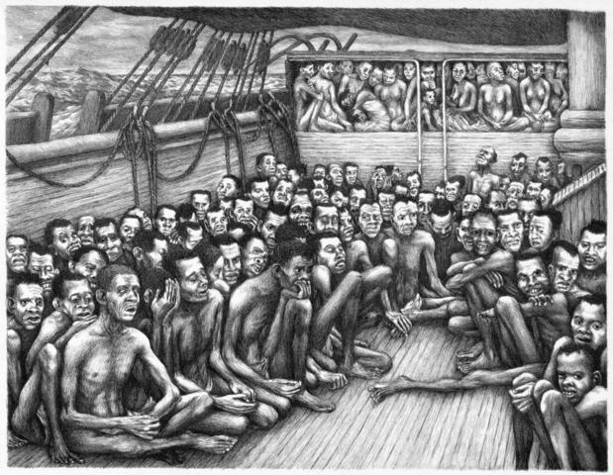
However, both the terms – legal and ethical – are spatio-temporal and change with time and space. For example, there was a time when slavery was legally justified
In the 17th, 18thand 19th centaury, capturing free men and deporting them away from their lands and families and was considered an economic necessity. Over a period of time, the law had been amended and redrafted to abolish slavery.
In other words, ethics emphasizes the rights of living beings (on humanitarian and moral grounds) and suggests it should not be violated by any means.

Slide 24
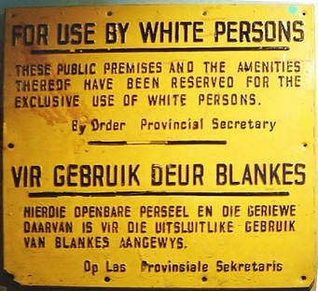
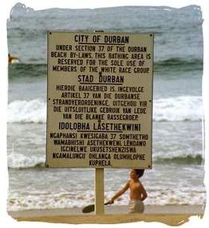
Apartheid ("separateness") was a system of institutionalised racial segregation and discrimination that existed in South Africa between 1948 and 1994. It was based on white supremacy and the repression of the black (African, Coloured and Indian) majority of the population for the benefit of the politically and economically dominant group, (Whites).

Slide 25
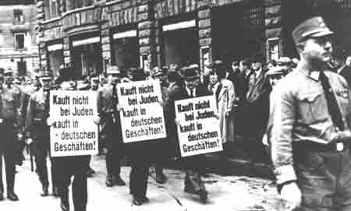
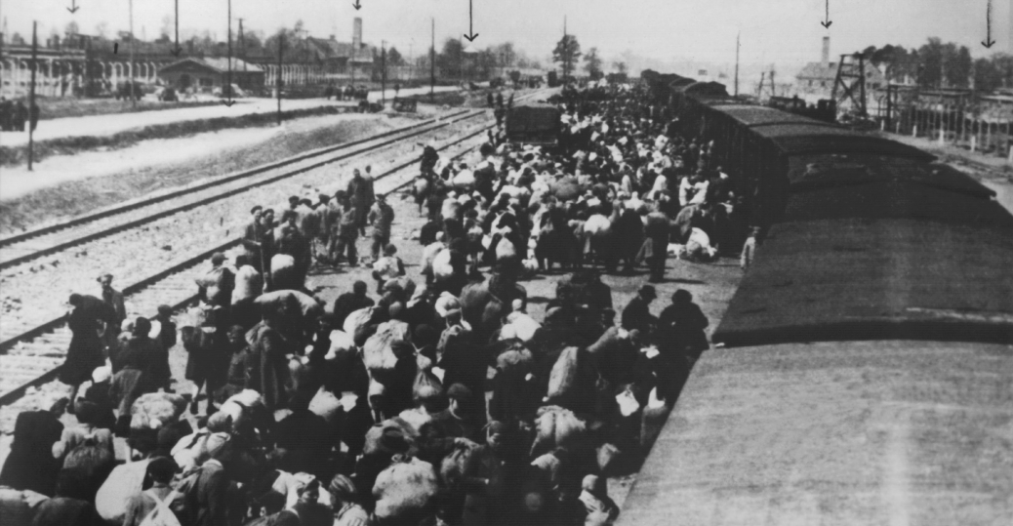
In its racial categorization, Nazism viewed what it called the Aryan race as the master race of the world—a race that was superior to all other races. It viewed Aryans as being in racial conflict with a mixed race people, especially the Jews, whom the Nazis identified as a dangerous enemy of the Aryans.To maintain the "purity and strength" of the Aryan race, the Nazis eventually sought to exterminate Jews, Gypsies, Slavs and the physically and mentally disabled.[

Slide 26
Rules to Professional Ethics in the Workplace
Professionalism is the conduct, aims or qualities that characterize or mark a profession or professional person; it implies quality of workmanship or service.
Always strive for excellence;
Be trustworthy;
Be courteous and respectful;
Be honest, open and transparent;
Be competent and improve continually;
Always be ethical;
Always be honorable and act with integrity;
Be respectful of confidentiality;
Set good examples;

Slide 27
BIBLOGRAPHY
1. Ruth Chadwick (1998). Professional Ethics. In E. Craig (Ed.), Routledge Encyclopedia of Philosophy. London: Routledge. Retrieved October 20, 2006
2. Manuel Velasquez, Claire Andre, Thomas Shanks, S.J., and Michael J. Meyer;
Issues in Ethics IIE V1 N1 (Fall 1987). Revised in 2010
3. What’s medical negligence? – Prof Ravindra Fernando: Senior Professor of Forensic Medicine and Toxicology at the University of Colombo [Sunday Times 24.02.2013]
4. Doctors, drug companies and medical ethics: A Sri Lankan perspective - G N Malavige, Lecturer in Microbiology, Faculty of Medical Sciences;University of Sri Jayawardanapura: DOI:
5. https://doi.org/10.20529/IJME.2004.012 Strike by workers paralyzes Sri Lanka health care - EFE Noticias
6. https://www.660citynews.com/wp-content/blogs.dir/sites/8/2019/09/EJX107-918_2019_024028.jpg
7.https://th.bing.com/th/id/R.2f0a59455a18b9503381cdc9c511b65a?rik=E2NzCZalg5X8bA&riu=http%3a%2f%2fwww.sundaytimes.lk%2f141012%2fuploads%2fNational-Hospital-Strike.jpg&ehk=ImgRaw&r=0
8. Wikipedia – Slavery
9. Wikipedia – Apartheid
10. Wikipedia – Holocaust
11. Wikipedia – I-35 Mississippi Bridge Failure
12a. Photograph 1- By Kevin Rofidal, United States Coast Guard - Contact us/Photo submission, Public Domain,
12b. Photograph 2 - By Mike Wills - Flickr, CC BY-SA 2.0,
13. Wikipedia – US Airways Flight 1549
13a. Photograph Chris McGrath/Getty Images News/Getty Images
14. Leandro Valente: 10 Golden Rules to Professional Ethics in the Workplace: Professional ⚙️MBA ☁️ Cyber Security MSc student @NCI ⚙️MCSA® ITIL®

Slide 28
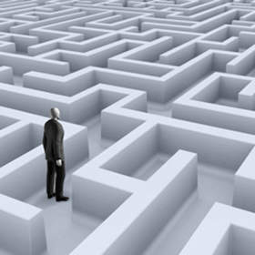

Slide 29
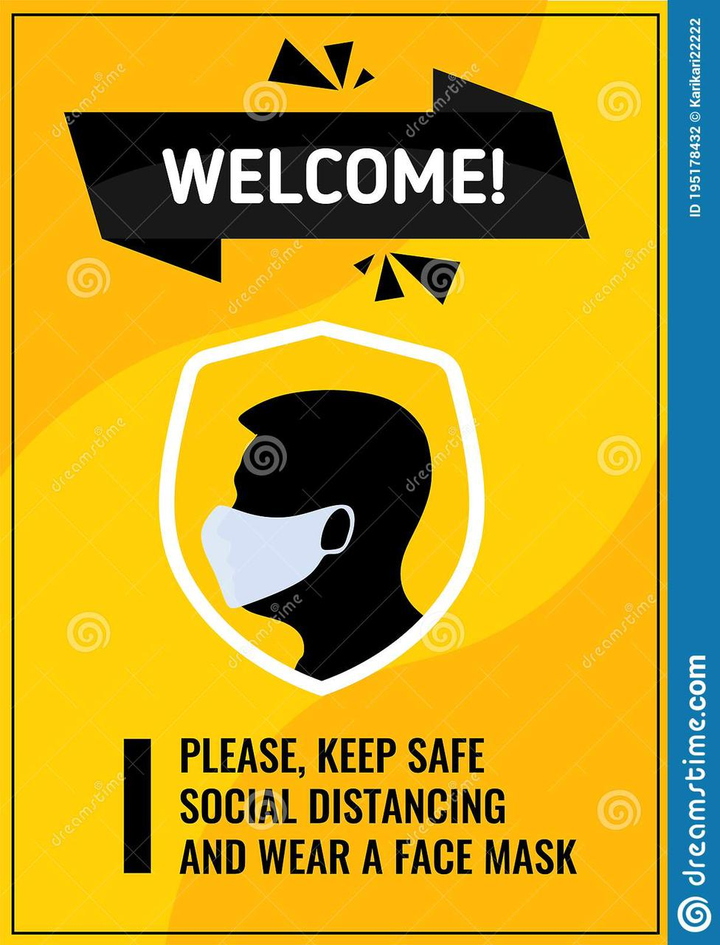
THANK YOU !!!!

